Slide 1
Everyone Can Design
Exploring Participatory User Experience Across Library Services
Joanna Messer Kimmitt, User Services Coordinator, CSU Dominguez Hills
#carlconf2018 @JoannaMesser
https://bit.ly/everyone-can-design-slides

Slide 2
For the next hour, we’ll….
Learn about participatory design
Cover criteria for choosing a design exercise
Review examples of design exercises
Cover some use cases for assessment
Do some group work: Select use case and select (maybe even prototype!) a design exercise
Share out
Evaluate the workshop

Slide 3
What we’re not covering….
How to pilot your test
Recruiting participants
Facilitation skills
Evaluating data (so much data)
Decisions about changes
Implementing changes

Slide 4
What is Participatory Design?

Slide 5
Basics of Participatory Design or Co-Design
Principles
Rooted in ethnography
Context-based
Actual behavior, not ideal behavior (descriptive, not prescriptive)
Holistic approach
Users are the experts
Cooperative
Practices
Observation
Interview (individual or group)
Exercises (in person or online or both)
Data analysis
Feedback
Iterative nature

Slide 6
Participatory Design Doesn’t Do It All
The only way to do things
Get yourself out of the way
Fix all the problems - nope!
Need-to-know basis

Slide 7
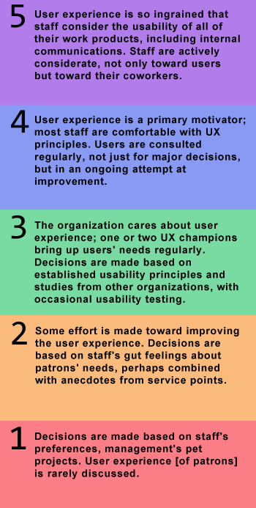
UX Stepladder
Where is your organization?
Sheldon-Hess, C. (2013 July). “UX, consideration, and a CMMI-based model. Retrieved from http://www.sheldon-hess.org/coral/2013/07/ux-consideration-cmmi/

Slide 8
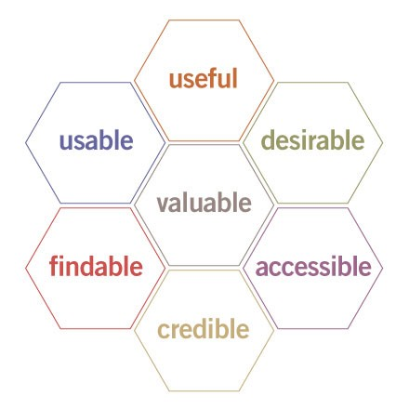
User Experience Honeycomb
Which characteristics are most important?
Morville, P. (2004, 21 June). “User Experience Design”, http://semanticstudios.com/user_experience_design/

Slide 9
Balance shoulds and needs with what users tell us

Slide 10
Questions?

Slide 11
Factors to Consider

Slide 12
Factors
Audience: Students? Faculty? Staff? Administration? Community connections?
Modalities: In person? Online? Hybrid?
Stakeholders: Who cares most? Least?
How many dimensions? Is it flat or is it 3D?

Slide 13
More Factors
Service/Instruction level expectations
“We’ve always done it this way”
Internal and external factors
Which factors are under your control? Which are not?
Context for exercise
What size is the group? How much time do you have?
Who is most invested in/affected by the outcome?

Slide 14
Questions?

Slide 15
Exercise Examples

Slide 16
Card Sorting
Categorization
Prioritization
Open sort
Closed sort
Keep it simple - no more than 40 cards

Slide 17
Love Letter/Breakup Letter
Love Letter
Describe positive qualities
Share honestly
Uncover the must-haves of a service, plan,
space, etc.
Smart Design. (2010). Love Letter/Breakup Letter. Retrieved from https://vimeo.com/11854531
Breakup Letter
Lets out tension around negatives
Share honestly
Uncover the detrimental aspects and pain
points

Slide 18
Photo Journaling as Diary Study
Describe existing features in a space
Photograph desired features existing elsewhere to import
Caption photographs
Can focus on the positive or negative aspects of a space/service

Slide 19
Journey Mapping
Journey Mapping
What is happening now
Can be elaborate or simple
Be realistic about good and not-so-good

Slide 20
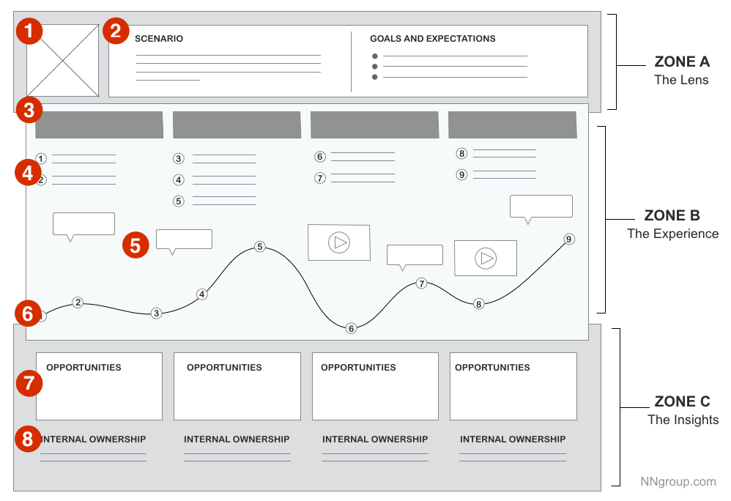
Fancy Journey Map
Highly detailed
Designers fill this out
Kaplan, K. (2016, July 31). When and how to create customer journey maps. Nielsen Norman Group. Retrieved from https://www.nngroup.com/articles/customer-journey-mapping/

Slide 21
Simple Journey Map
Service:
How do you use it? Use the tools on the table to share (draw, glue things to the paper - have fun!).
How do you feel about it? (Draw, use stickers - have fun!)
Where do you get stuck?
What might make it easier?

Slide 22
Keep in mind....

Slide 23
Facilitation Tips
Testing the process, not the user!
Affirm the user’s experience
Center on the user
Be present
Avoid distractions
Respect their time
Follow through & follow up

Slide 24
Questions?

Slide 25
Design Use Cases
bit.ly/everyone-can-design-handout

Slide 26
User/Access Services
Requesting an item not available from browsable area
Course Reserves
Storage
ASRS
Archives/Special Collections
Specialized collections like a curriculum room
Other closed stacks

Slide 27
Reference/Research Services
Finding research assistance in-person
Website tools (research or course guides)
Reference desk
Chat/virtual reference tools
Scheduling a research consultation with a librarian
Finding aids embedded in discovery services (i.e. CSU’s OneSearch)
Data visualization and data management

Slide 28
Technology/Space Services
Requesting an equipment item and/or reserving a space within the library
Website tools (calendar or scheduler)
Services listings on website
Maps and directional signage
Frequently Asked Questions
Notifying users of terms and conditions
Procedural changes
Policies (including privacy)

Slide 29
Instruction Services
Engaging with a new faculty member for an instruction session for their course
Past practices with this particular department for course-level instruction
Institutional best practices for one-shot or on-going teaching
Library’s program goals for assessment
Department’s program goals for assessment
Past encounters the faculty member has had with library instruction
Goals for curricular integration of information literacy instruction
Desired learning outcomes

Slide 30
Intra-Library Work
Determining practices for collaboration and communication
Meeting agendas and minutes
Knowledge management for documentation
Collaboration across and within departments in the library
Setting norms for decision-making and expectations at meetings
Project planning in short- and long-term activities

Slide 31
Questions?

Slide 32
Choosing An Exercise

Slide 33
Questions to Consider
What method will you use?
Who’s your audience?
What are your hypotheses?
How might you use the results to make change?
How will you communicate your results to people who participated?

Slide 34
Share Out Your Plan

Slide 35
Questions to Answer - Reporting Out
What method will you use?
Who’s your audience?
What are your hypotheses?
How might you use the results to make change?
How will you communicate your results to people who participated?
What will you take home with you from this session?

Slide 36
Thank you!
Joanna Messer Kimmitt
User Services Coordinator/Liaison Librarian
California State University Dominguez Hills
jkimmitt@csudh.edu
Kimmitt, J. M. (2018, April 14.) Everyone can design. Presentation at CARL Conference 2018, Redwood City, CA.
Slides and materials are CC-BY-SA 4.0

Slide 37
References & Useful Resources
Card Sorting Tools - Online: OptimalSort, UXSort, uzCardSort (and many others)
Kaplan, K. (2016, July 31). When and how to create customer journey maps. Nielsen Norman Group. Retrieved from
https://www.nngroup.com/articles/customer-journey-mapping/
Krug, S.(2014). Don’t make me think, revisited : A common-sense approach to web and mobile usability (3rd ed.). San Francisco: New
Riders.
Morville, P. (2004, June 21). User experience design. Retrieved from http://semanticstudios.com/user_experience_design/
Schmidt, A. and Etches, A. (2014). Useful, usable, desirable : Applying user experience design to your library. Chicago: ALA
Editions.
Sheldon-Hess, C. (2013, July 25). UX, consideration, and a CMMI-based model. Retrieved from
http://www.sheldon-hess.org/coral/2013/07/ux-consideration-cmmi/
Smart Design. (2010). Love Letter/Breakup Letter. Retrieved from https://vimeo.com/11854531
Stanford d.school. Resources. Retrieved from https://dschool.stanford.edu/resources/
Weave, the Journal of Library User Experience. Retrieved from https://www.weaveux.org
Usability.gov. Retrieved from https://www.usability.gov
Young, S. W. H. User experience and design. Retrieved from https://scottwhyoung.com/user-experience-design/

